Slide 1










Knowledge Discovery & Insights from Unstructured Data ANALYTICS FOR UNSTRUCTURED DATA Session 2, 08/24/2023
Dr. Anitesh Barua
David Bruton Jr. Centennial Chair Professor of Business
Distinguished Fellow, INFORMS Information Systems Society
University of Texas Distinguished Teaching Professor
McCombs School of Business, University of Texas at Austin
Email: anitesh.barua@mccombs.utexas.edu
Many slides in this deck are based on “Mine Your Own Business” article by Netzer et al.

Slide 2
The General Idea
Unstructured data such as conversations can reveal new insights about brands, products & events
The idea
Don’t ask questions (as in a survey)
Find out what people are talking about
Find key entities (e.g., brands, products, etc.) & attributes (e.g., service, price, etc.)
Find associations between words
Visualize, correlate with business outcomes (e.g., switching)
© Anitesh Barua, 2023

Slide 3
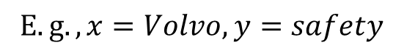
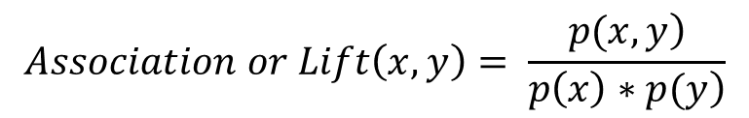
Co-occurrence of Terms
Do terms or words appear together in messages by chance or due to real association?
E.g., is Volvo more likely to mentioned in conjunction with safety related words than Toyota?
Is Honda more likely to be associated with reliability than, say, Jaguar?
$$Let x and y represent two words or phrases$$
$$E.g., x=Volvo, y=safety$$
$$Association or Lift\left(x,y\right)= \frac{\left.p(x,y\right)}{\left.p\left(x\right)∗p(y\right)}$$
$$where p\left(x,y\right) is the probability of both x \& y appearing in a message$$
$$where p\left(x\right) is the probability of x appearing in a message$$
$$where p\left(y\right) is the probability of y appearing in a message$$

Slide 4
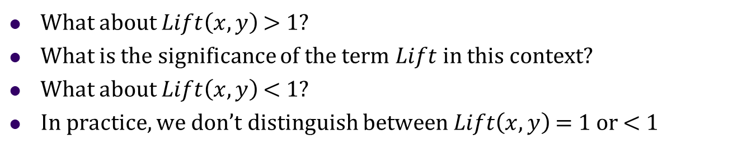
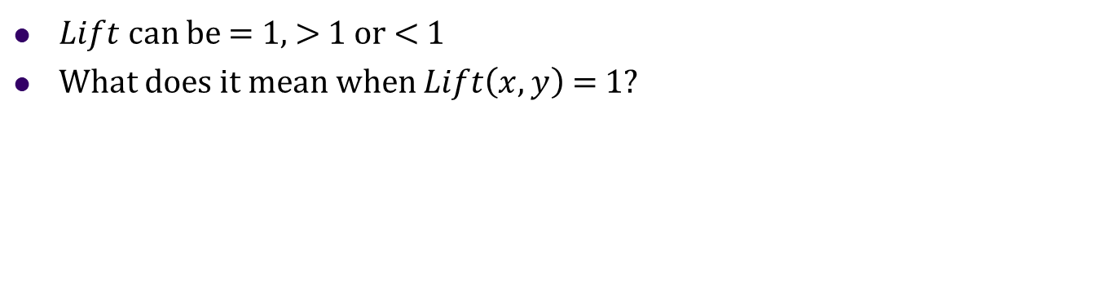
Interpretation of Lift
$Lift$can be = 1, > 1 or < 1
What does it mean when $Lift\left(x,y\right)$ = 1?
What about $Lift\left(x,y\right)$ > 1?
What is the significance of the term $Lift$ in this context?
What about $Lift\left(x,y\right)$ < 1?
In practice, we don’t distinguish between $Lift\left(x,y\right)$ = 1 or < 1

Slide 5
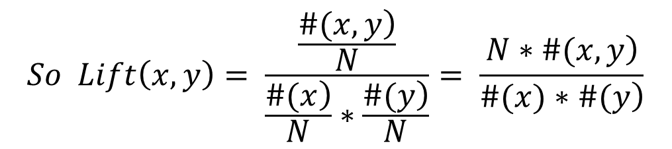
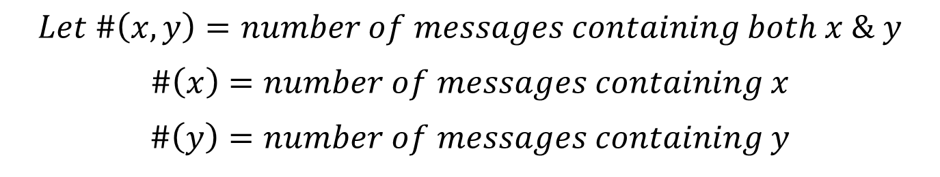
An Frequentist Interpretation of Lift
$$Let \#\left(x,y\right)=number of messages containing both x \& y$$
$$\#\left(x\right)=number of messages containing x$$
$$\#\left(y\right)=number of messages containing y$$
$$Then p\left(x,y\right)=\frac{\left.\#(x,y\right)}{N}, p\left(x\right)= \frac{\left.\#(x\right)}{N}, p\left(y\right)= \frac{\left.\#(y\right)}{N}$$
$$So Lift\left(x,y\right)= \frac{\frac{\left.\#(x,y\right)}{N}}{\frac{\left.\#(x\right)}{N}∗\frac{\left.\#(y\right)}{N}}= \frac{\left.N∗\#(x,y\right)}{\left.\#(x)∗\#(y\right)}$$
© Anitesh Barua, 2023

Slide 6











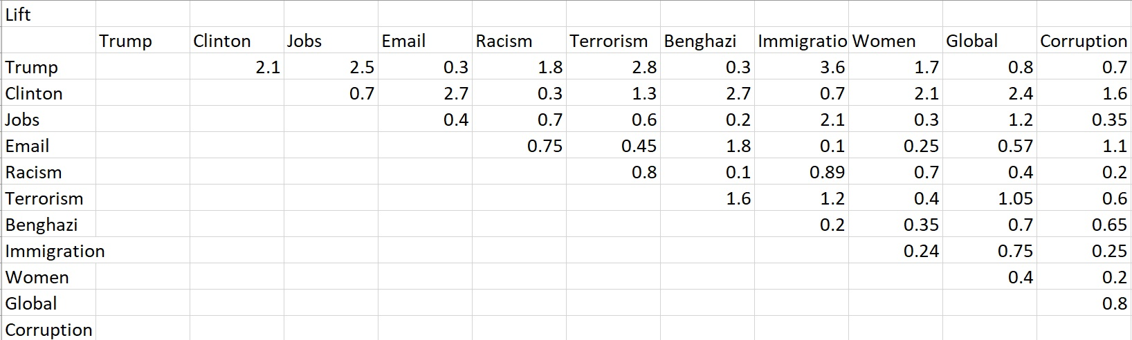
Which Associations are Strong?
?
© Anitesh Barua, 2023

Slide 7
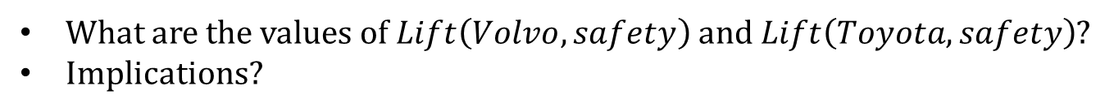
An Example from Edmunds.com
 | Toyota Camry | Volvo S40
# mentions | 34,559 | 2320
# co-mentions with safety related words | 379 | 120
Lift of make/model & safety related words
Total # messages: 868,174 (assume one make/model
appears only once in a message
Safety related messages: 4534
What are the values of $Lift\left(Volvo,safety\right)$and $Lift\left(Toyota,safety\right)$?
Implications?

Slide 8

What Does This Ad Say?
Do car enthusiasts and customers feel the same way?

Slide 9

Should we Emphasize Both Performance & Luxury?

Slide 10
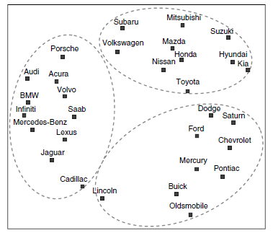
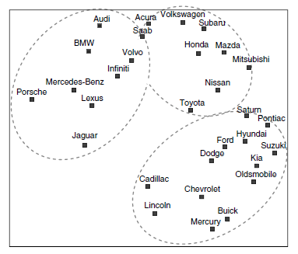
Can We Predict Switching Behavior?
Forum co-mentions
(~100k mentions)
Actual brand switching
(3.5 million)

Slide 11
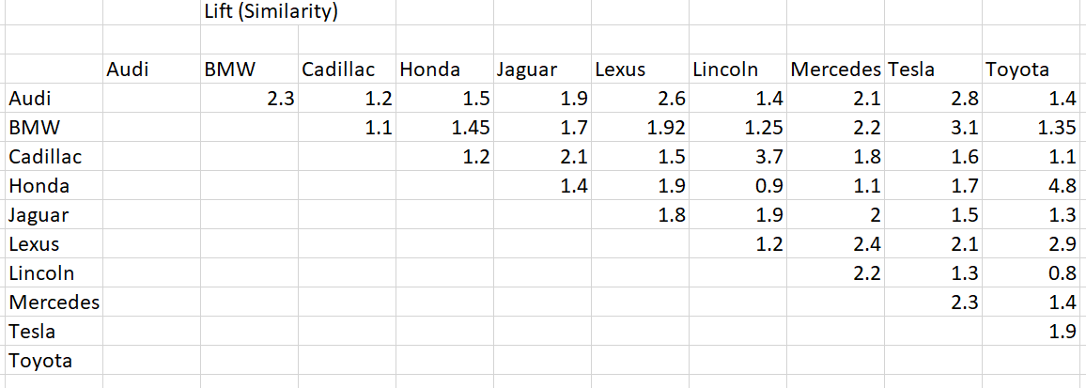
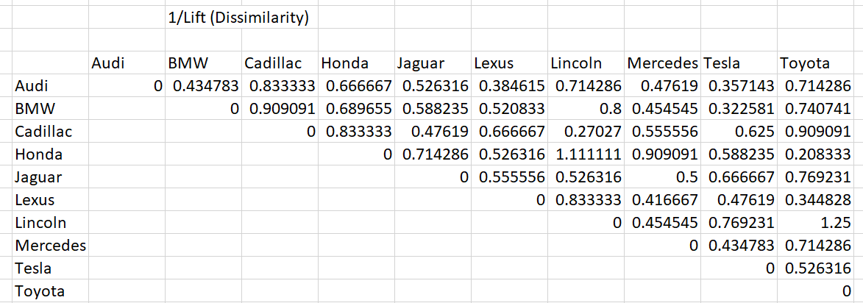
How to Draw an MDS Plot
Should we plot the lift values directly?
© Anitesh Barua, 2023

Slide 12
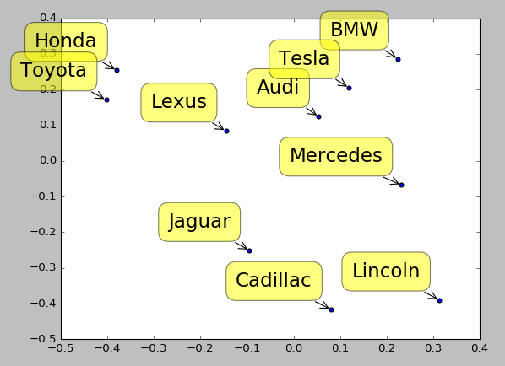
What do the MDS Axes Represent?
© Anitesh Barua, 2023

Slide 13
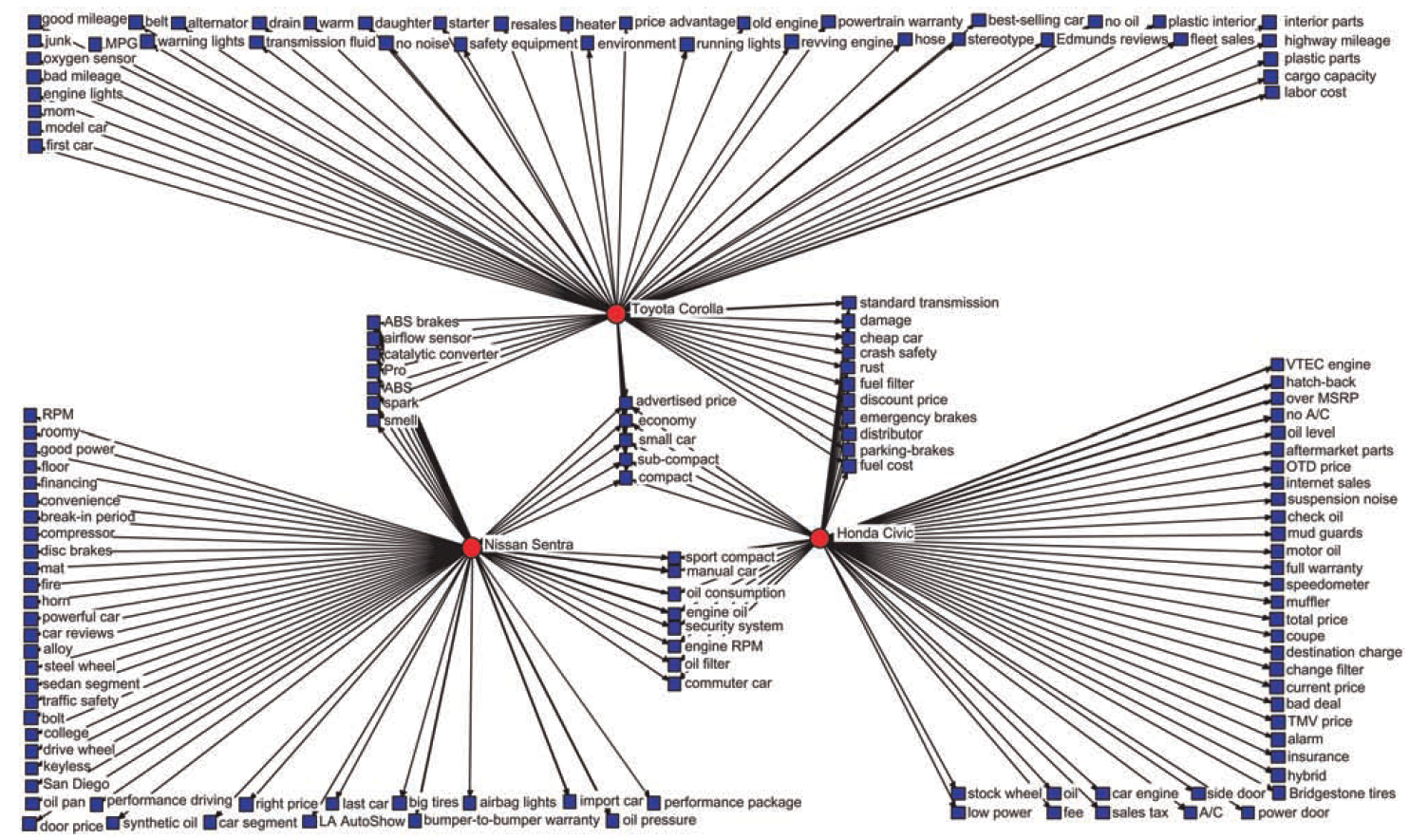
Product Attribute Associations

Slide 14
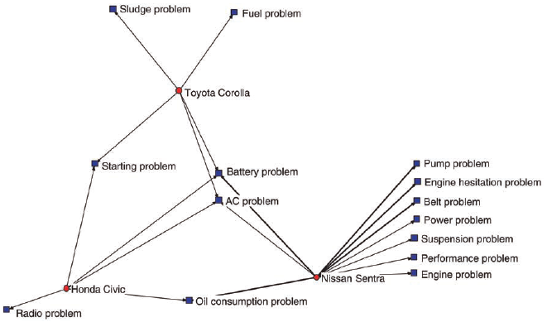
Negative Perceptions

Slide 15
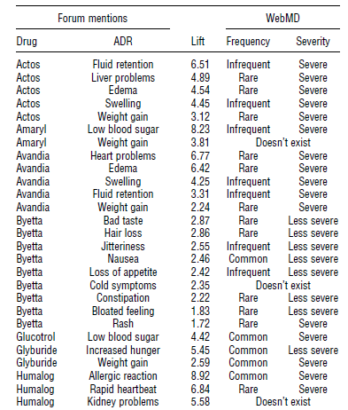
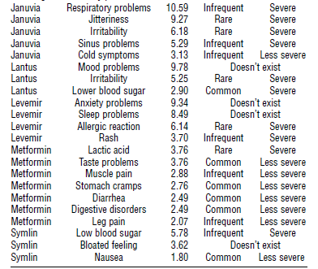
Crowds Vs. Experts

Slide 16
Beyond Pairwise Association
Do people compare Audi & BMW when they discuss performance?
Mentions
of Audi
Mentions
of BMW
#(A,B,P)
Mentions of
Performance
All Mentions
© Anitesh Barua, 2023

Slide 17
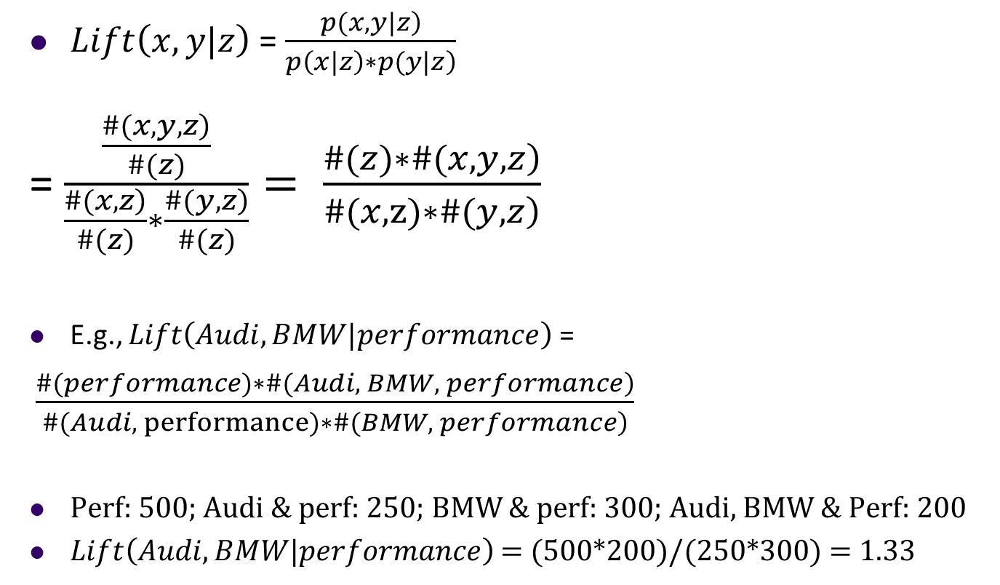
Conditional Lift
$Lift\left(x,y|z\right)$ = $\frac{\left.p(x,y|z\right)}{\left.p\left(x|z\right)∗p(y|z\right)}$
= $\frac{\frac{\left.\#(x,y,z\right)}{\#(z)}}{\frac{\left.\#(x,z\right)}{\#(z)}∗\frac{\left.\#(y,z\right)}{\#(z)}}= \frac{\left.\#(z)∗\#(x,y,z\right)}{\left.\#(x,z)∗\#(y,z\right)}$
E.g., $Lift\left(Audi,BMW|performance\right)$=
$\frac{\left.\#(performance)∗\#(Audi, BMW, performance\right)}{\left.\#(Audi, performance)∗\#(BMW, performance\right)}$
Perf: 500; Audi & perf: 250; BMW & perf: 300; Audi, BMW & Perf: 200
$Lift\left(Audi,BMW|performance\right)$ = (500*200)/(250*300) = 1.33
© Anitesh Barua, 2023

Slide 18
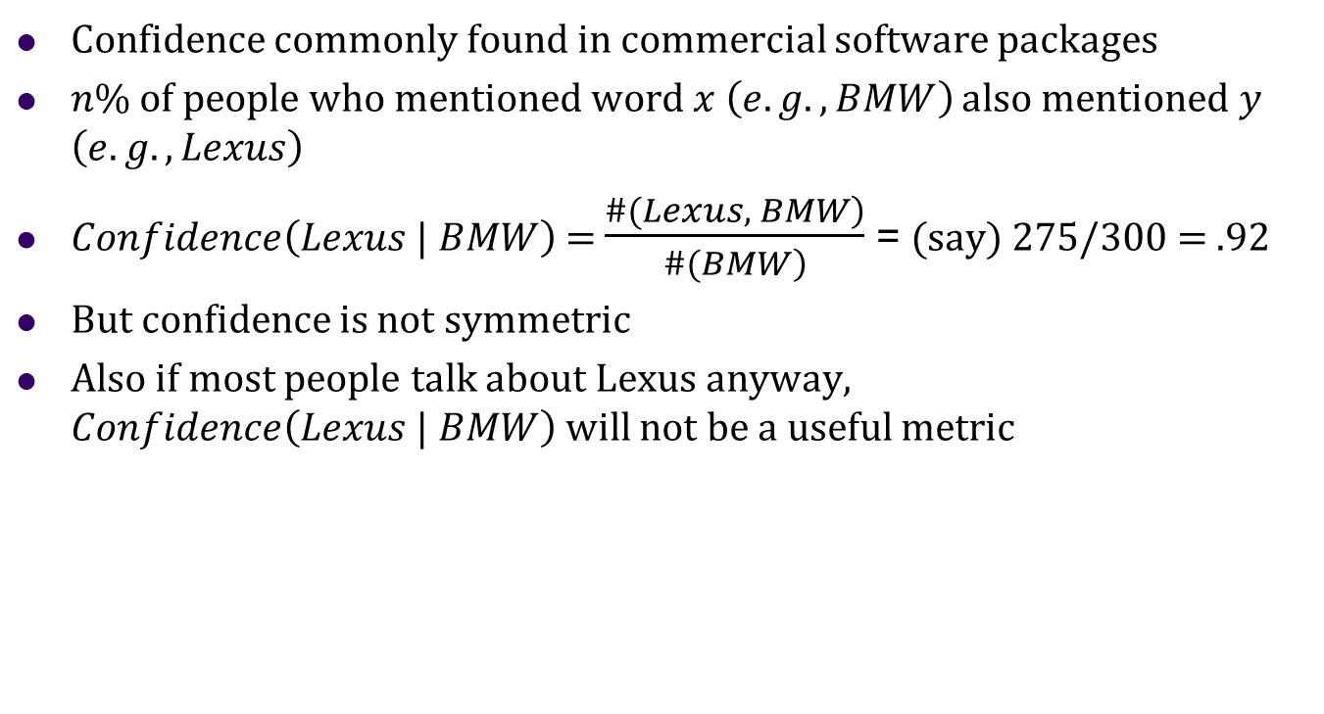
How is Lift Different from Confidence in This Context?
Confidence commonly found in commercial software packages
$n\%$ of people who mentioned word $x \left(e.g., BMW\right)$ also mentioned $y$ $\left(e.g., Lexus\right)$
$Confidence\left(Lexus | BMW\right)$= $\frac{\left.\#(Lexus, BMW\right)}{\left.\#(BMW\right)}$ = (say) 275/300 = .92
But confidence is not symmetric
Also if most people talk about Lexus anyway, $Confidence\left(Lexus | BMW\right)$will not be a useful metric
© Anitesh Barua, 2023

